Slide 1


Skill India Mission
Yatin Ajmani Mehak Adlakha Rohit Singh Souvik Chakraborty

Slide 2

FACTS!
• India homeland for 17.5 % of total population of the globe.
• 65% of total population in India is under 35 years.
•INDIA with 2.4% existent land mass of total.
•Just 3.5% of the country’s workforce is skilled as against the global average of 40 to 50%.
•SKILL INDIA basis of ‘make in India’.

Slide 3
WHO ARE WE?
Skill India Mission to increase the number of skilled man power across different sectors.
Renewable Energy Sector : Energy for our children’s children’s children!
Fortunately successful.
DBMS – Need to store and extract relevant information efficiently.
Skill Council for Green Jobs (SCGJ)

Slide 4
ASSUMPTIONS
1 candidate – Many Qualification Packs
1 Training Partner – Many Training Centers
1 Training Centers- Many Qualification Packs
1 Training Partner – Many Qualification Packs
1 Qualification Packs – Many Training Centers
1 Qualification Packs – Many Training Partners
1 Batch – 1 Training Partners, 1 Assessment Agency
1 Assessment Agency – Many Assessment Centers
1 candidate – 1 Batch for a particular duration
Passing criteria 40%
Enrollment is just the registration with SCGJ without any batch assigned yet.

Slide 5
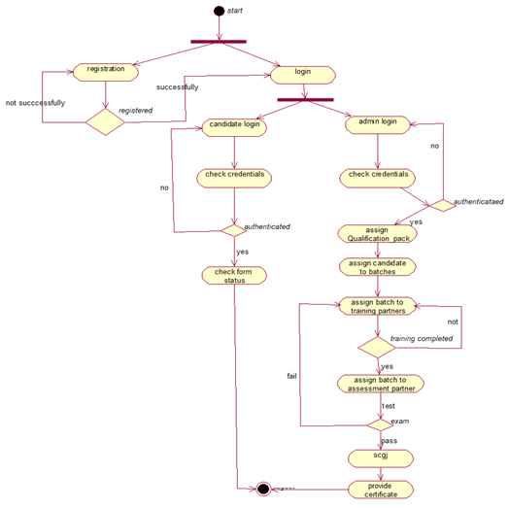
WORKFLOW

Slide 6
DATABASE SCHEMA DIAGRAM

Slide 7
SQL FOR CREATION OF TABLES

Slide 8
SQL FOR SAMPLE DATA CREATION

Slide 9
SQL FOR FREQUENTLY ASKED QUESTIONS

Slide 10
LIST OF QUESTIONS PREPARED

Slide 11
THANK YOU

Slide 12
ANY FEEDBACK?
We would love to hear from you.

